Slide 1

UNIVERSITY INSTITUTE OF ENGINEERING
DEPARTMENT OF COMPUTER SCIENCE AND ENGG.
Bachelor of Engineering (Computer Science & Engineering)
DATA STRUCTURES 21CSH-211
DISCOVER . LEARN . EMPOWER

Slide 2
Agenda
Sorting
Bubble Sort
Insertion Sort
Selection Sort
Merge Sort

Slide 3
Sorting
Sorting refers to arranging data in a particular format. Sorting algorithm specifies the way to arrange data in a particular order. Most common orders are in numerical or lexicographical order.
The importance of sorting lies in the fact that data searching can be optimized to a very high level, if data is stored in a sorted manner. Sorting is also used to represent data in more readable formats. Following are some of the examples of sorting in real-life scenarios −
Telephone Directory − The telephone directory stores the telephone numbers of people sorted by their names, so that the names can be searched easily.
Dictionary − The dictionary stores words in an alphabetical order so that searching of any word becomes easy.

Slide 4
Sorting
Sorting takes an unordered collection and makes it an ordered one.
1 2 3 4 5 6
77
42
35
12
101
5
1 2 3 4 5 6
5
12
35
42
77
101

Slide 5
Sorting Techniques
Sorting technique depends on the situation. It depends on two parameters.
1. Execution time of program that means time taken for execution of program.
2. Space that means space taken by the program.
Sorting techniques are differentiated by their efficiency and space requirements.

Slide 6
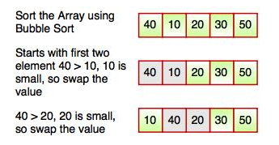
Bubble Sort
Bubble sort is a simple sorting algorithm. This sorting algorithm is comparison-based algorithm in which each pair of adjacent elements is compared and the elements are swapped if they are not in order. This algorithm is not suitable for large data sets as its average and worst case complexity are of Ο(n2) where n is the number of items.

Slide 7
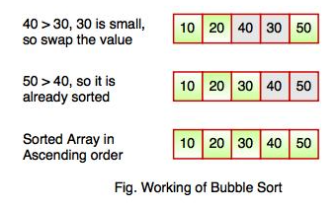
Bubble Sort
The above diagram represents how bubble sort actually works. This sort takes O(n²) time. It starts with the first two elements and sorts them in ascending order.
Bubble sort starts with first two elements. It compares the element to check which one is greater.
In the above diagram, element 40 is greater than 10, so these values must be swapped. This operation continues until the array is sorted in ascending order.

Slide 8
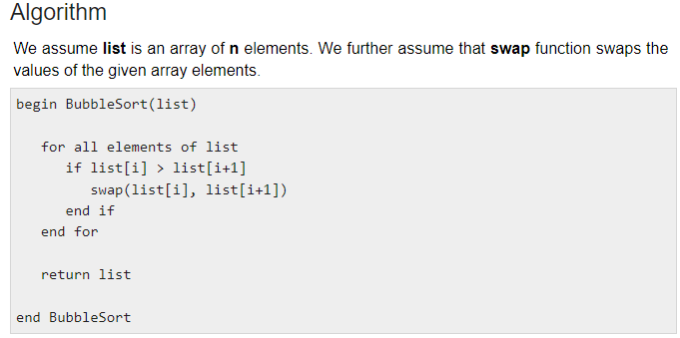
Bubble Sort

Slide 9
Insertion Sort
Insertion sort is a simple sorting algorithm.
This sorting method sorts the array by shifting elements one by one.
It builds the final sorted array one item at a time.
Insertion sort has one of the simplest implementation.
This sort is efficient for smaller data sets but it is insufficient for larger lists.
It has less space complexity like bubble sort.
It requires single additional memory space.
Insertion sort does not change the relative order of elements with equal keys because it is stable.

Slide 10
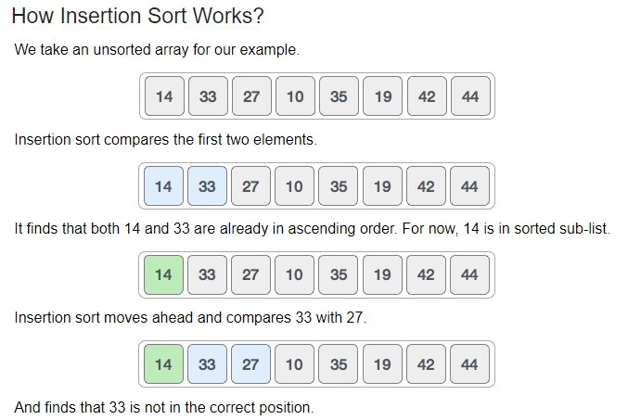
Insertion Sort

Slide 11
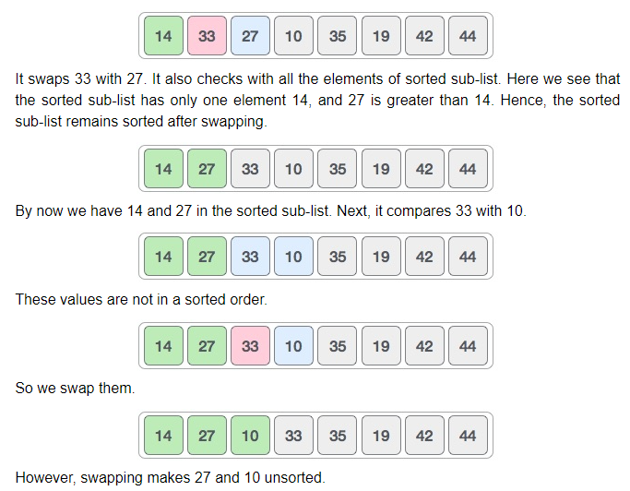
Insertion Sort

Slide 12
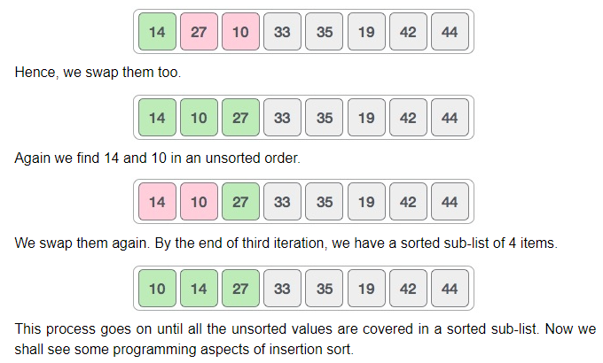
Insertion Sort

Slide 13
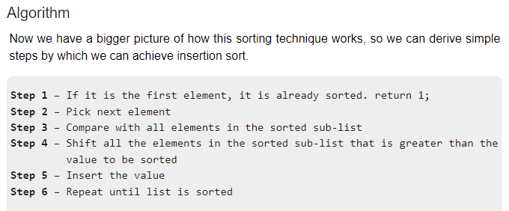
Insertion Sort

Slide 14
Selection Sort
Selection sort is a simple sorting algorithm. This sorting algorithm is an in-place comparison-based algorithm in which the list is divided into two parts, the sorted part at the left end and the unsorted part at the right end. Initially, the sorted part is empty and the unsorted part is the entire list.
The smallest element is selected from the unsorted array and swapped with the leftmost element, and that element becomes a part of the sorted array. This process continues moving unsorted array boundary by one element to the right.
This algorithm is not suitable for large data sets as its average and worst case complexities are of Ο(n2), where n is the number of items.

Slide 15
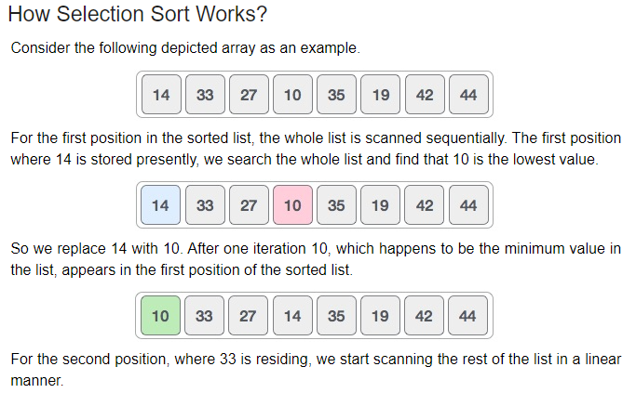
Selection Sort

Slide 16
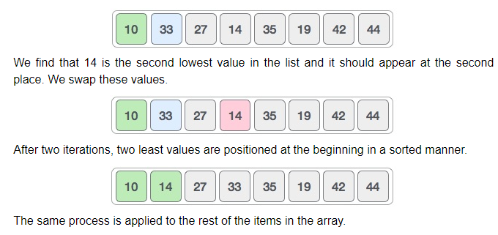
Selection Sort

Slide 17
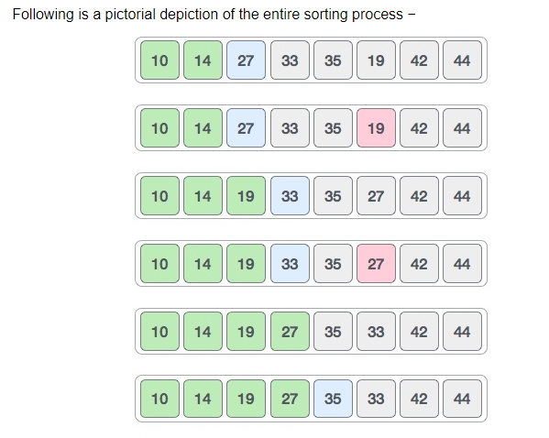
Selection Sort

Slide 18
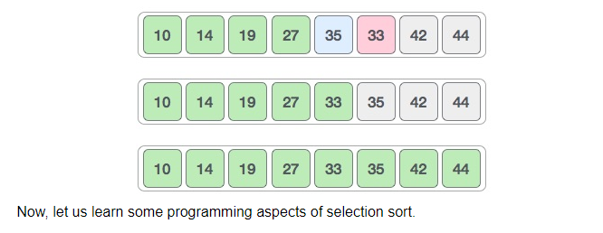
Selection Sort

Slide 19
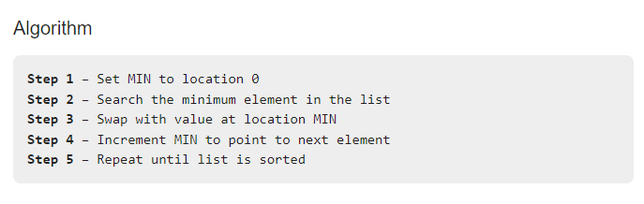
Selection Sort

Slide 20
Merge Sort
Merge sort is a sorting technique based on divide and conquer technique. With worst-case time complexity being Ο(n log n), it is one of the most respected algorithms.
Merge sort first divides the array into equal halves and then combines them in a sorted manner.

Slide 21
Algorithm
Merge sort keeps on dividing the list into equal halves until it can no more be divided. By definition, if it is only one element in the list, it is sorted. Then, merge sort combines the smaller sorted lists keeping the new list sorted too.
Step 1 − if it is only one element in the list it is already sorted, return.
Step 2 − divide the list recursively into two halves until it can no more be divided.
Step 3 − merge the smaller lists into new list in sorted order.

Slide 22
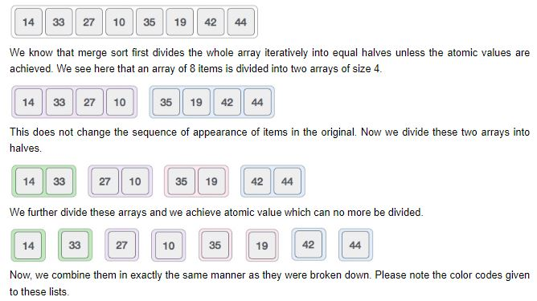
How Merge Sort Works?
To understand merge sort, we take an unsorted array as the following −

Slide 23
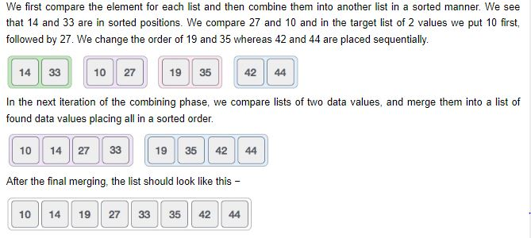

Slide 24
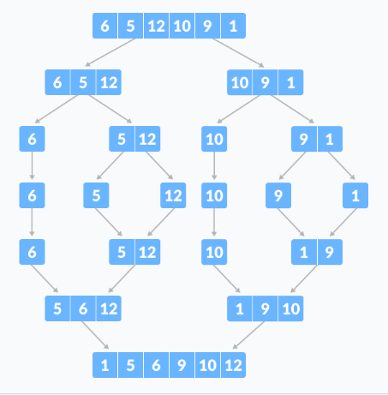
Example

Slide 25
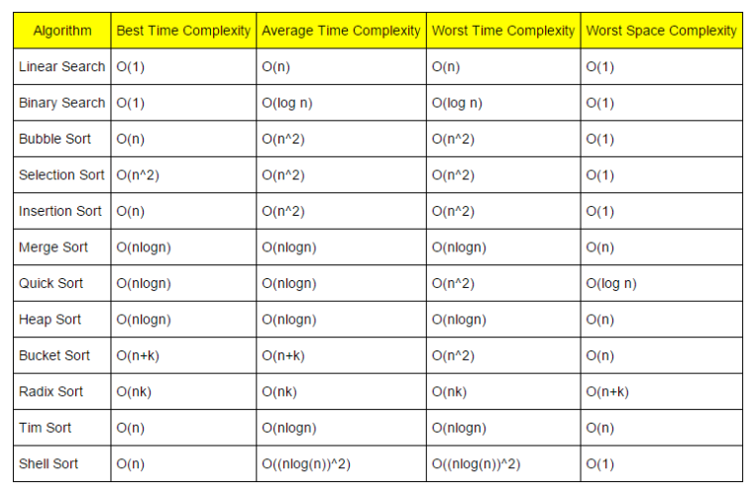
Complexity Analysis

Slide 26
Classify Sorting Algorithms
Based on Number of Swaps or Inversion.
number of times the algorithm swaps elements to sort the input. Selection Sort requires the minimum number of swaps.
Based on Number of Comparisons.
number of times the algorithm compares elements to sort the input.
Using Big-O notation, the sorting algorithm require examples listed above at least O(n log n) comparisons in the best case and O(n²) comparisons in the worst case for most of the outputs.

Slide 27
Based on Recursion or Non-Recursion.
Quick Sort, use recursive techniques to sort the input.
Other sorting algorithms, such as Selection Sort or Insertion Sort, use non-recursive techniques.
Merge Sort, make use of both recursive as well as non-recursive techniques to sort the input.
Based on Extra Space Requirement
Sorting algorithms are said to be in place if they require a constant O(1) extra space for sorting.

Slide 28
Insertion sort and Quick-sort are in place sort as we move the elements about the pivot and do not actually use a separate array which is NOT the case in merge sort where the size of the input must be allocated beforehand to store the output during the sort.
Merge Sort is an example of out place sort as it require extra memory space for it’s operations.

Slide 29
Problem 1:
Given a list with numbers (6,5,12,10,9,1). Apply merge sort and sort the given list. Also implement the same using any programming language in recursive mode and iterative. Derive the complexity for the Best and Worst case for Merge sort. Do specify various applications of Mergesort.

Slide 30
Problem 2:
Given a list with numbers {52, 37, 63, 14, 17, 8, 6, 25}, Apply Quick sort and sort the given list. Also implement the same using any programming language like c, c++ or Java in iterative mode and recursive. Derive the complexity for the Best and Worst case for Quick sort. Do specify various applications of Quicksort.

Slide 31
Problem 3:
Given a list A = (10,7,2,5,11)
Apply Cycle sort and sort the given list. Also implement the same using any programming language like c, c++ or Java in recursive mode and iterative . Derive the complexity for the Best and Worst case for cycle sort. Do specify various applications of cycle sort.

Slide 32
SOLVE THIS EXAMPLE BASED ON COUNT SORT
4. Example:
Say A={5,2,9,5,2,3,5}.
Aux will be of the size 9+1 i.e. 10
Aux={0,0,2,1,0,3,0,0,0,2}. Notice that Aux[2]=2 which represents the number of occurrences of 2 in A[]. Similarly Aux[5]=3 which represents the number occurrences of 5 in A[].
After applying the counting sort algorithm, sortedA[] will be {2,2,3,5,5,5,9}

Slide 33
References
Lipschutz, Seymour, “Data Structures”, Schaum's Outline Series, Tata McGraw Hill.
Goodrich, Michael T., Tamassia, Roberto, and Mount, David M., “Data Structures and Algorithms in C++”, Wiley Student Edition.
https://www.tutorialspoint.com/data_structures_algorithms/algorithms_basics.htm
https://www.cs.utexas.edu/users/djimenez/utsa/cs1723/lecturehtml
https://www.w3resource.com/php-exercises/searching-and-sorting-algorithm/searching-and-sorting-algorithm-exercise-4.php
https://www.programiz.com/dsa/merge-sort
https://www.geeksforgeeks.org/binary-search/

Slide 34
THANK YOU

